Slide 1


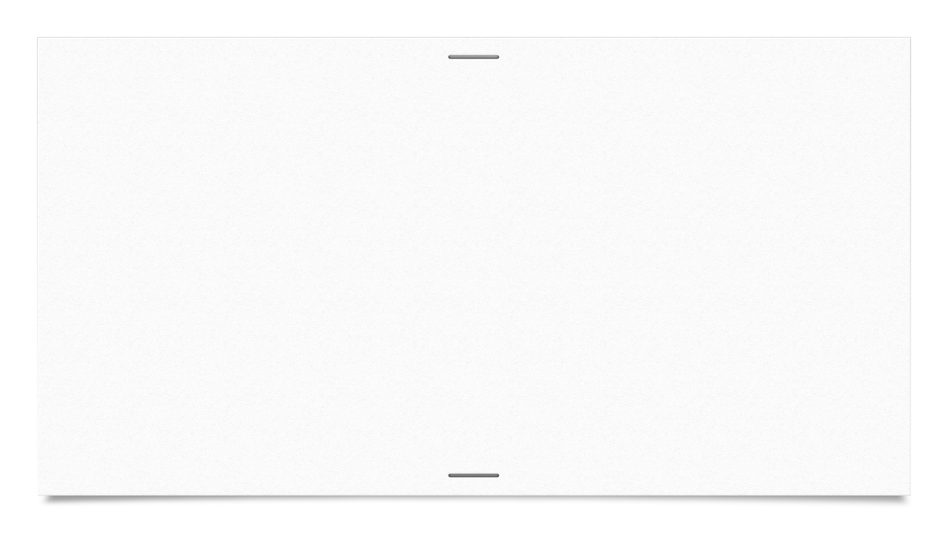

Supplier Management Problem - Yashwanth Raj Varadharajan (G47635180)
Problem Statement
To maintain a steady supply of goods, the grocery store needs to manage its relationships with suppliers. Each supplier provides different types of products, and the store needs to keep track of supplier names, contact information, and the products they supply. Design a data model to represent the relationship between suppliers and the products they supply to the store. You will write applications to order from suppliers and to maintain the supplier table.
Problem Summary
Store buys products from suppliers who supply different kinds of products. We need to design a data model to manage relationships between suppliers and the products they provide for a grocery store, including supplier names, contact details, and product information.

Slide 2
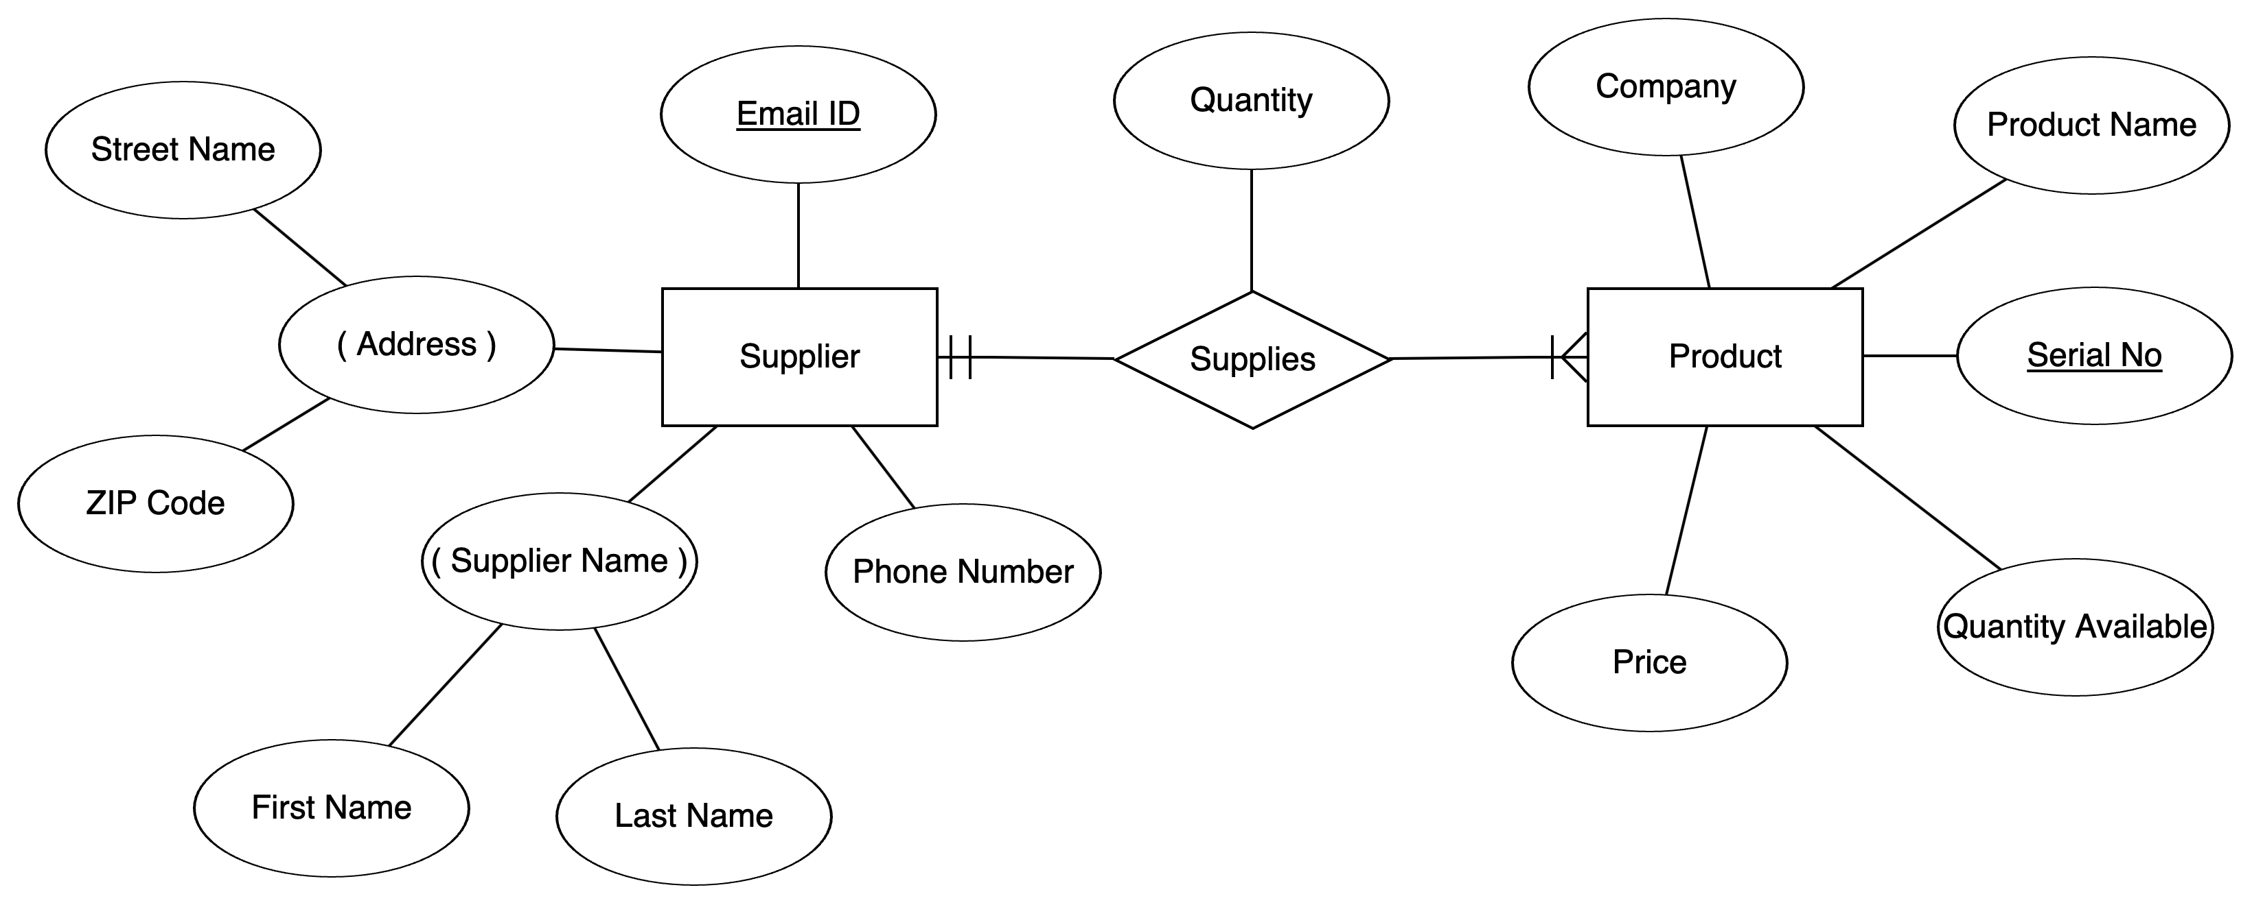
Chen ERD

Slide 3
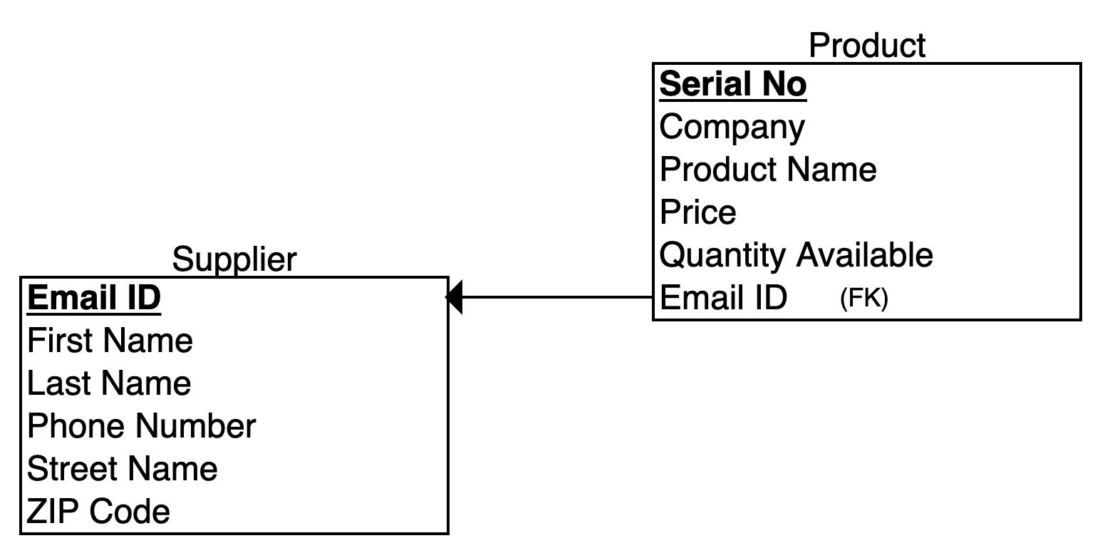
Relational ERD

Slide 4
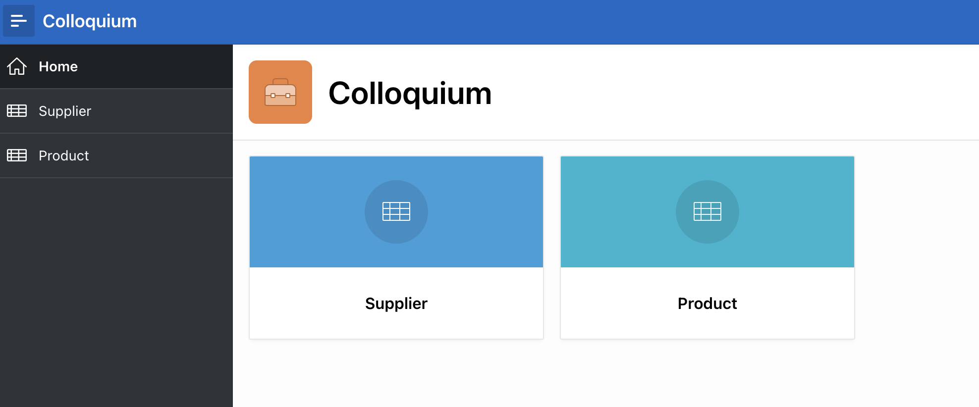
Apex App
Appl Link

